Slide 1

FUN FACTS REGARDING
THE NASHVILLE CITY CEMETERY
BY
PATRICK ATWATER

Slide 2
Did you know?
Nashville Cemetery contains nearly 20,000 graves
From the famous to the anonymous
11th US President James K Polk is buried at NCC
Died 1849
Grave can be found on Central Ave (Brick Work)
Over 50 Graves of the unknown

Slide 3
When?
NCC contains graves from over 100 years
Deaths by Year and Sex

Slide 4
Top years for burials at NCC

Slide 5
Who?
Deaths by Age group and time period

Slide 6
How?
Consumption: a progressive wasting away of the body especially from pulmonary tuberculosis

Slide 7
By month?
Cholera often spread by drinking contaminated water

Slide 8
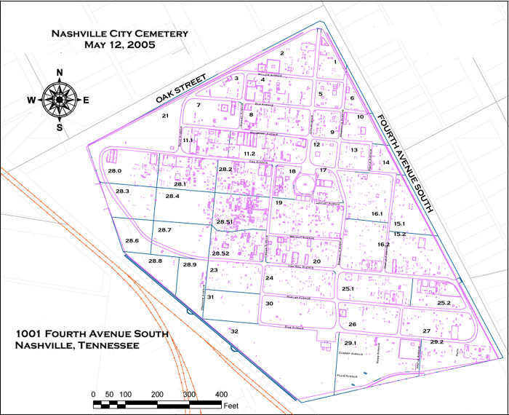
What’s in a name?
Top last names among buried at NCC: Smith(129), Brown (112), Johnson (96), Jones(83), Williams(70), Green (60)
How about a game?
Grab a map and see how many of the top name graves you can find.

